Slide 1
How to get your microphone working!

Slide 2
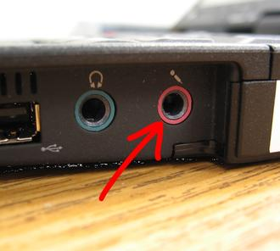
Step one
First you want to make sure that you headphone jack and microphone jack, are in the right slot; it is a common mistake but can easily be fixed
On Connections computers you will
most likely see something like this.
but it will be located on the front of
your desktop

Slide 3
What to do
Your microphone wire will be colored red to indicate that that wire is dedicated to your microphone! What you want to do is connect your red wire into the slot that has the picture of a microphone once that is done then you can move on to the next step

Slide 4
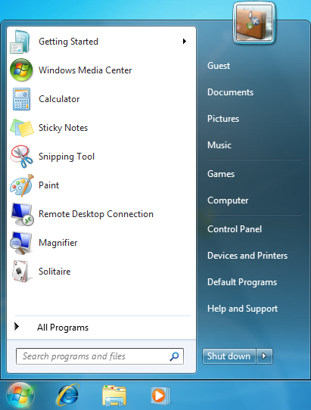
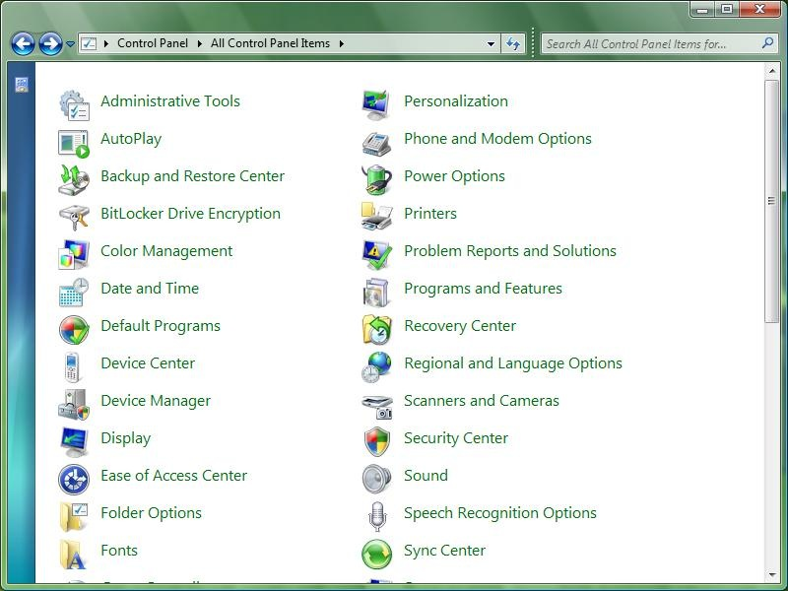
Step two
Check to see if that got your microphone working.
What you need to do is click the windows icon in the bottom left corner of your desktop, then click control panel which will open another tab

Slide 5
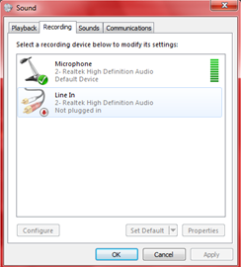
What to do
What you want to do now is click on the sound option once you have done this you can close the control panel. Another tab will open and there will be four microtabs, click the one that says record. Once you do that, if your microphone is set up, it will show up on that screen. Then start speaking. If a green bar appears, then it’s working and you’re good to go. If not, then continue to the next slide.

Slide 6
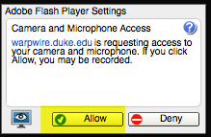
Step three
When you try to start a video call for the first time, you'll see a message underneath the address bar asking for permission to access your computer's microphone and camera.
Click Allow. You only need to do this once. The Chrome browser will remember your choice for future Hangouts.
The Red circle in the address bar of the Chrome browser: This means the browser's tab is using your microphone and camera.

Slide 7
Check refer back to step two
After doing this, do one of two things: either have the person you’re talking to say something if they can hear you, or repeat step two.

Slide 8
Step four
If your microphone is still not working then you may need to go into your browser settings and make sure you didn’t have your microphone on an exception for the site your using. otherwise it won’t work.

Slide 9
Step five
If your microphone STILL isn’t working, you should send it back to Connections and ask for another because possibly this microphone is broken.

Slide 10
Entering the LiveLesson Room
Be sure to plug in your headset with microphone before you go into the LL room.
Be sure to “allow” permission for microphone and webcam use as you enter the LL room or your headset microphone won’t work.

